Slide 1
The Dimensions of happiness
Authored by:
Jenn Brockman, Soumya murali, heather barker, Sebastian Munoz, and Chris Elliott

Slide 2
World Happiness report
The World Happiness Report is a landmark survey of the state of global happiness, was released at the United Nations at an event celebrating International Day of Happiness on March 20th. The report continues to gain global recognition as governments, organizations and civil society increasingly use happiness indicators to inform their policy-making decisions. Leading experts across fields – economics, psychology, survey analysis, national statistics, health, public policy and more – describe how measurements of well-being can be used effectively to assess the progress of nations. The reports review the state of happiness in the world today and show how the new science of happiness explains personal and national variations in happiness.
Our project – hap-py
Our project focused on why are countries happy? What types of things do they have in common, if anything?

Slide 3
Country Statistics - UNData
The United Nations Statistics Division (UNSD) of the Department of Economic and Social Affairs (DESA) launched a new internet based data service for the global user community. It brings UN statistical databases within easy reach of users through a single entry point (http://data.un.org/). This dataset contains key statistical indicators of the countries. It covers 4 major sections
General Information
Economic Indicators
Social Indicators
Environmental & Infrastructure Indicators

Slide 4
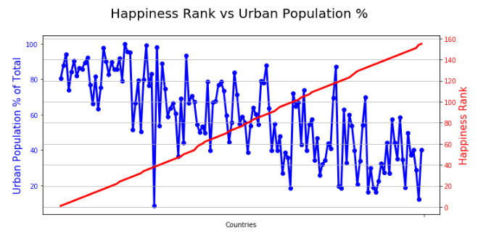
Urban populations tend to be happier
In the top 20 happiest countries the urban population is 83% of the total, while in the bottom 20 it only makes up 34%.

Slide 5
Urban populations outlier
Trinidad and Tobago, is the extreme lower point on the Urban Population chart, they are the 38th happiest country with only 8.4% Urban Population

Slide 6
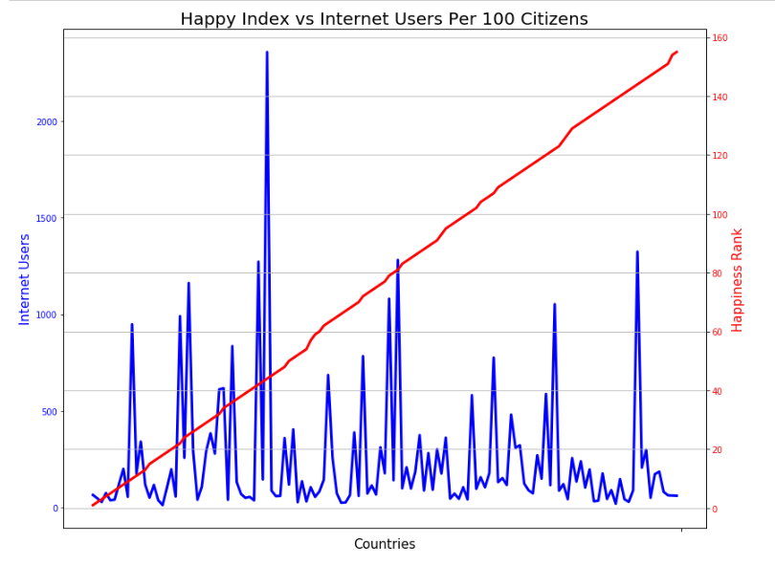
Internet users per 100 inhabitants
In the top 20 happiest countries the average internet users were 213.25 per 100 inhabitants, in the bottom 20 counties the average was 166.35.

Slide 7
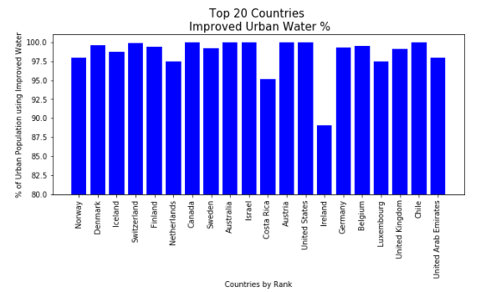
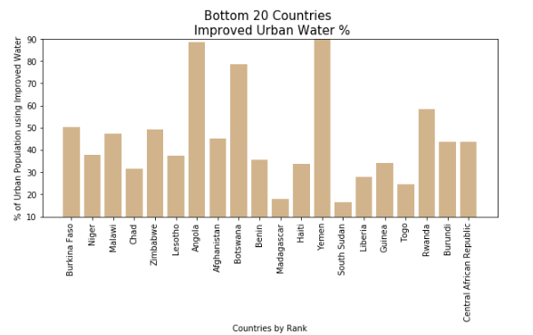
Countries with improved drinking water facilities tend to be happier
The top 20 happiest countries the population using improved drinking water facilities was an average of 98.5%,
while the bottom 20 was only 44.7%.

Slide 8
Infrastructure conclusion
While this is not conclusive, the 3 factors presented Urban Population, Internet Users and Improved Drinking water facilities those that had higher averages were “happier” countries.

Slide 9
Michelin Restaurants
Do Michelin Restaurants increase the happiness in a country?

Slide 10
Where did I find the data and why did I use it?
I pulled the data from Kaggle.
It had a 9.4 in usability.
The data was separated mostly by countries which was what I needed to compare it to the happiness data.

Slide 11
Analysis Process:
First, I had to clean the data and remove columns that I would not need which included restaurant names , zip codes and a few other columns for both the happiness and restaurant data. Some of the countries were broken down by states or provinces so I had to combine a few of the rows so that they were with the corresponding countries.
Then came the merging, the Michelin restaurant data was divided up by three csv files by star quantity, so I had to combine them so I get the total restaurant count for each country I then merged the Michelin data with the Happiness data.

Slide 12
Analysis process cont’d.
Once the two data sets were merged, I checked for duplicates, there were none, but some of the rows had NaN’s so I used .fillna(0) to convert them to zero.
I then took the merged data and created two different data frames, one for the top 20 happiest countries and the other for the lowest 20 happiest countries.
Finally I plotted the data, I used bar graphs and a scatter plot as they best showed the data.

Slide 13
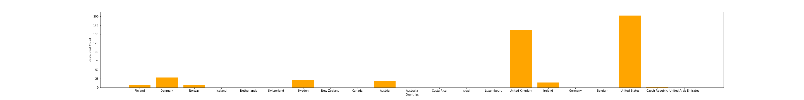
2018 Top 20 happiest countries and Michelin restaurant totals bar graph

Slide 14
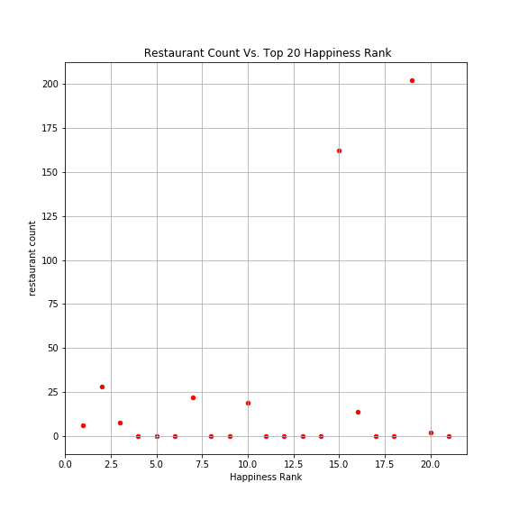
2018 Top 20 happiest countries Vs. Michelin restaurant totals bar graph

Slide 15
Observation:
There was no real correlation between happiness and total Michelin Restaurants, however there was a correlation between Super Power countries (US,UK) and high Michelin restaurant totals.
A little over half of the countries have no Michelin Restaurants

Slide 16

2018 lowest 20 happiest countries and Michelin restaurant totals bar graph

Slide 17
Observation:
The 20 countries with the lowest happiness ranks have no Michelin restaurants.

Slide 18
Conclusion:
There was no real correlation between the top 20 happiest countries and their Michelin restaurant counts. However there was correlation between the 20 countries with the lowest happiness rank and Michelin restaurant counts, where the saddest countries don’t have any Michelin restaurants. In conclusion, while Michelin restaurants can't guarantee high happiness, it could increase it slightly.

Slide 19
Suicide rates among the top ten happiest countries
What does it all mean?

Slide 20


Here's your outline to get started
Key facts
An estimated 1 million people worldwide die by suicide every year. It is estimated that global annual suicide fatalities could rise to over 1.5 million by 2020. Globally, suicide ranks among the three leading causes of death among those aged 15–44 years. Attempted suicides are up to 20 times more frequent than completed ones.
Per recent WHO releases, social stigma, the taboo to openly discuss suicide, and low availability of data lead to poor data quality for both suicide and suicide attempts: "given the sensitivity of suicide – and the illegality of suicidal behaviour in some countries – it is likely that under-reporting and misclassification are greater problems for suicide than for most other causes of death.
It is important to remember however that at a global level, suicide has declined by 29% since 2000.
See more: Open the Notes below for more information.

Slide 21

Related topics to research
Do happy people commit suicide
Suicide by age groups
Gender differences in suicide
Happiness score vs suicide
Suicide in western countries
Suicide in Norway
Suicide in Denmark
Suicide in Iceland
Suicide in Switzerland
Suicide in Finland
Suicide in Netherlands
Suicide in Canada
Suicide in New Zealand
Suicide in Sweden
Suicide in Australia
Use Smart Lookup to learn more
1
Highlight one of the related topics
Right-click on the topic
Choose "Smart Lookup"
2
3

Slide 22
Contents
International trends in suicide among the top ten countries 2000-2016 data
Total suicide by age
Total suicide by gender
Total suicide by country

Slide 23
Trends in suicide among the ten happiest countries
At a global level, suicide has declined by 29% since 2000.
There is a correlation among the age groups
More males commit suicide than females*
Happiness has no correlation to suicide

Slide 24
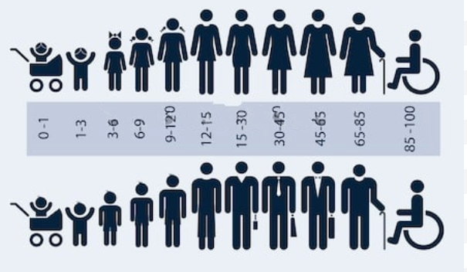
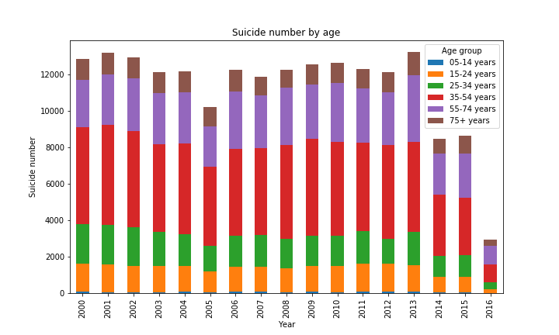
Suicide - does age matter?

Slide 25
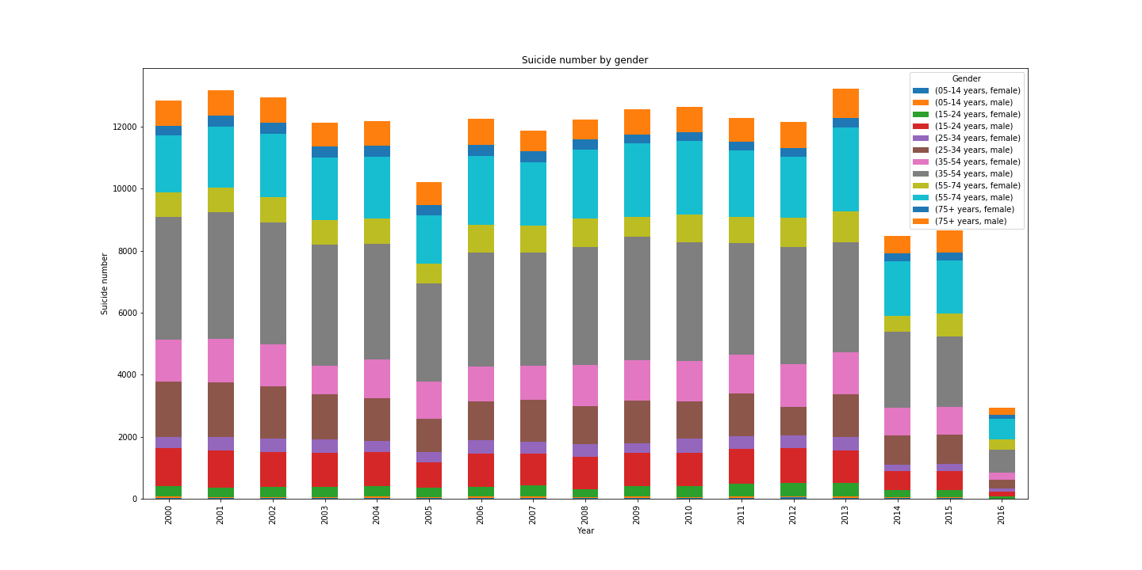

Gender vs the numbers

Slide 26
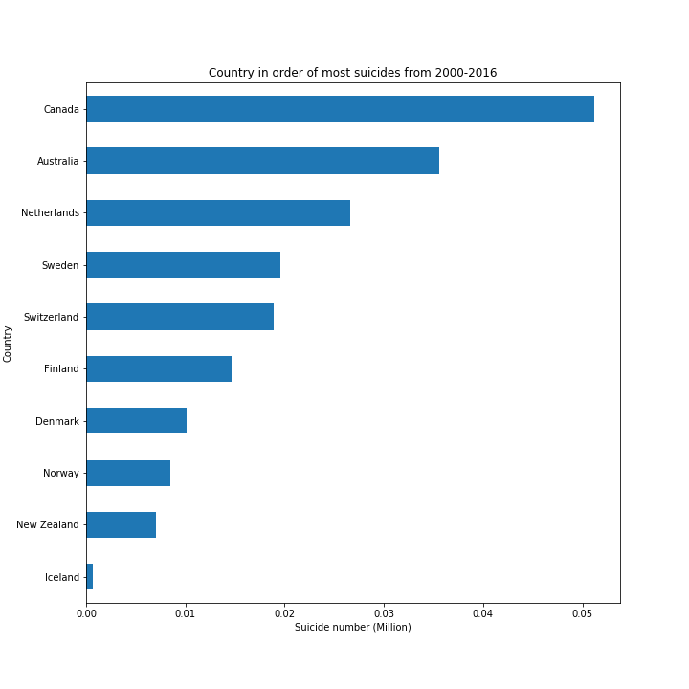
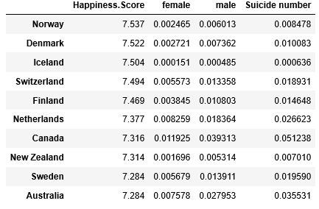
Top ten happiest vs the numbers

Slide 27

Notes:
Consider talking about:
By state
College students
Military
LGBTQ
Chronic pain
Autism

Slide 28
Works cited
World Happiness dataset: https://www.kaggle.com/unsdsn/world-happiness
Suicide dataset: https://www.kaggle.com/russellyates88/suicide-rates-overview-1985-to-2016
Rates are falling: https://www.economist.com/the-economist-explains/2018/11/30/why-the-global-suicide-rate-is-falling
Suicide Prevention Hotline: https://suicidepreventionlifeline.org/

Slide 29
HOW Do Family, Economic GDP per Capita, Health Life Expectancy, Social Freedom, Economic Freedom, Generosity, and Corruption influence happiness scores?

Slide 30
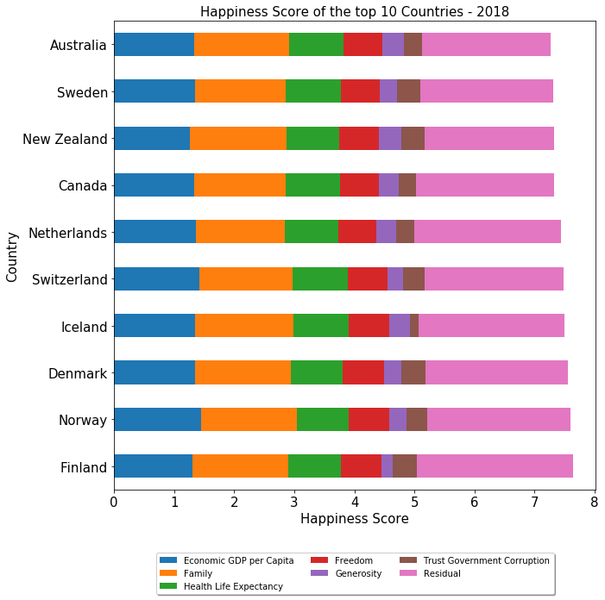
World Happiness Report Data Analysis (2015 - 2018)
Purpose of this project is to find happiest countries in the world and analyze world happiness report to understand the factors contributing to happiness score.
This project also tries to relate happiness score of countries with external elements to identify and understand possible trends.
According to 2018 happiness report, Finland is ranked as happiest country with a happiness score of 7.632 and United States is ranked as 18th.
In 2018, 7 countries in top ten are from Western Europe, 2 of them are Australia and New Zealand and 1 country (Canada) from North America.
‘Economic GDP per Capita’ and ‘Family’ are major contributors toward happiness score.
External factors ‘World Unemployment Rate’ and ‘Economic Freedom Data’ is analyzed to explore the relationship between happiness score and these factors.

Slide 31
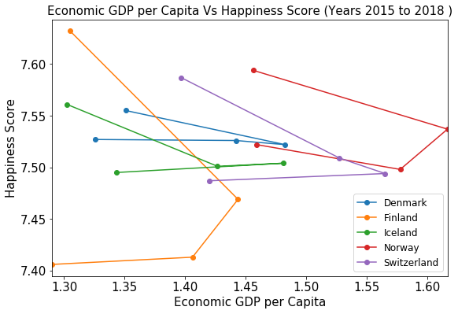
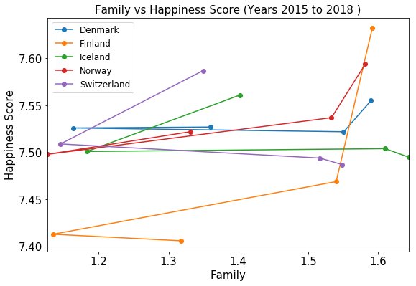
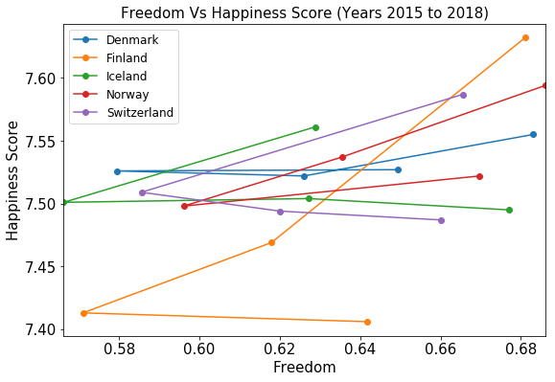
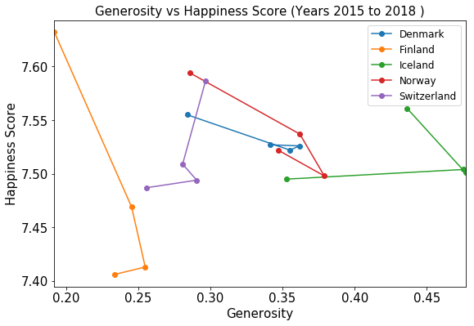
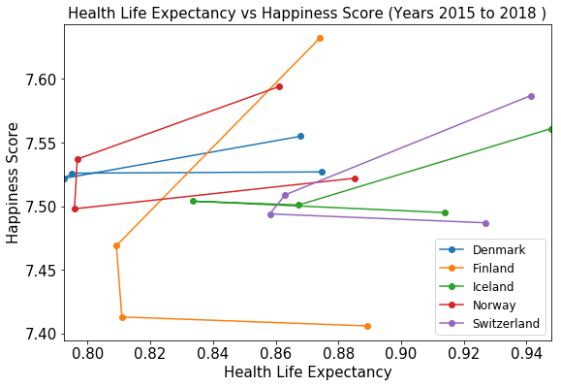
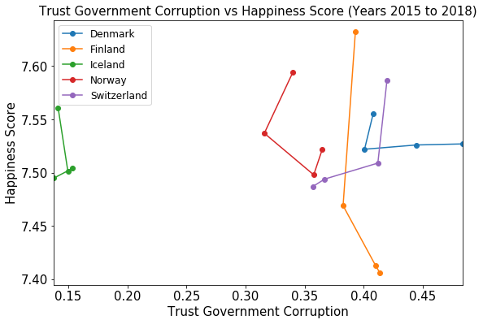
Analyzing Individual Factors Contributing to Happiness Score (2015 - 2018)
Analyzing individual factors of top 5 countries
Family, Freedom and Health Life Expectancy contributes positively towards happiness score.
Economic GDP per Capita is a major contributor but it is not a strong deciding factor for happiness score in case of top 5 countries.
Generosity and ‘Trust Government Corruptions’ does not provide any conclusive trends towards happiness score .

Slide 32
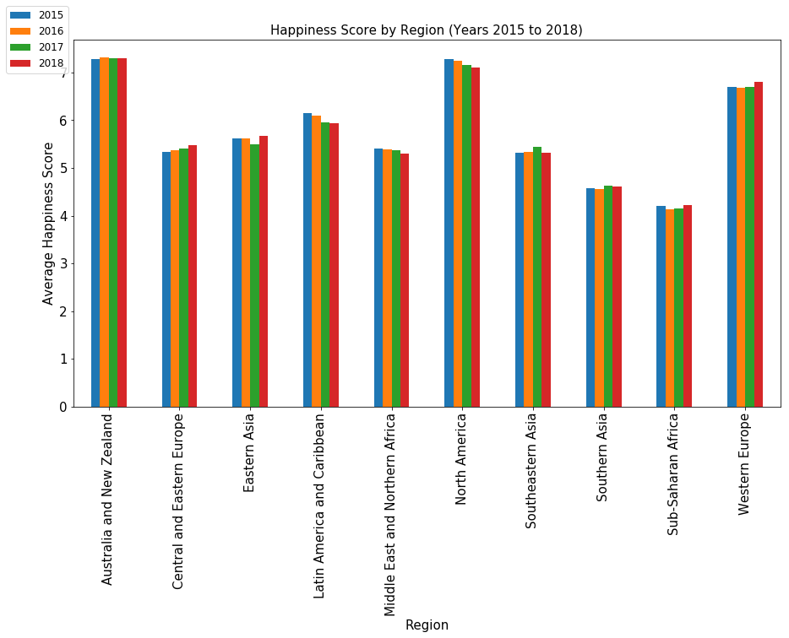
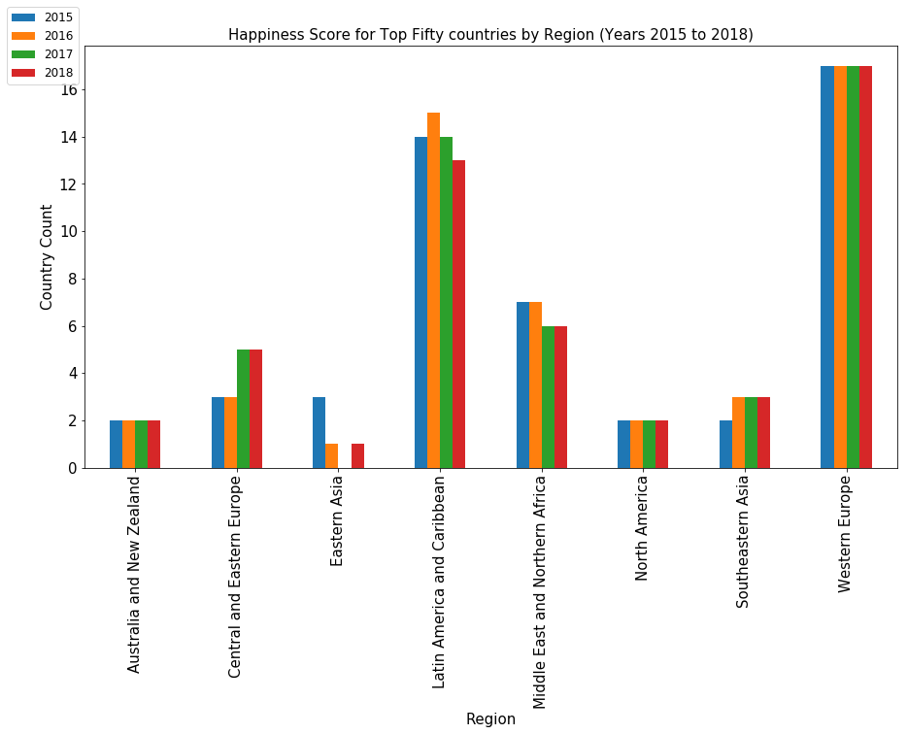
Analyzing Happiness Score By Region (2015- 2018)
Australia and New Zealand, North America and Western Europe are the happiest regions.
Sub-Saharan Africa and Southern Asia are the least happy regions.
Happiness score in Central and Eastern Europe increase over the years while North America, Latin America and Caribbean see a decrease
Australia and NZ [2 out of 2] and North America [2 out of 2] are constantly in top 50 in last 4 years.
Western European countries represent most number [17 out of 21], followed by Latin America and Caribbean countries.
None of the countries from Southern Asia and Sub-Saharan Africa made into top 50 in last 4 years.

Slide 33
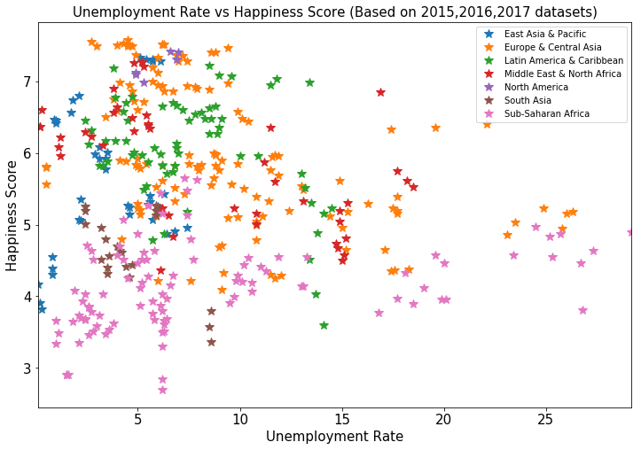
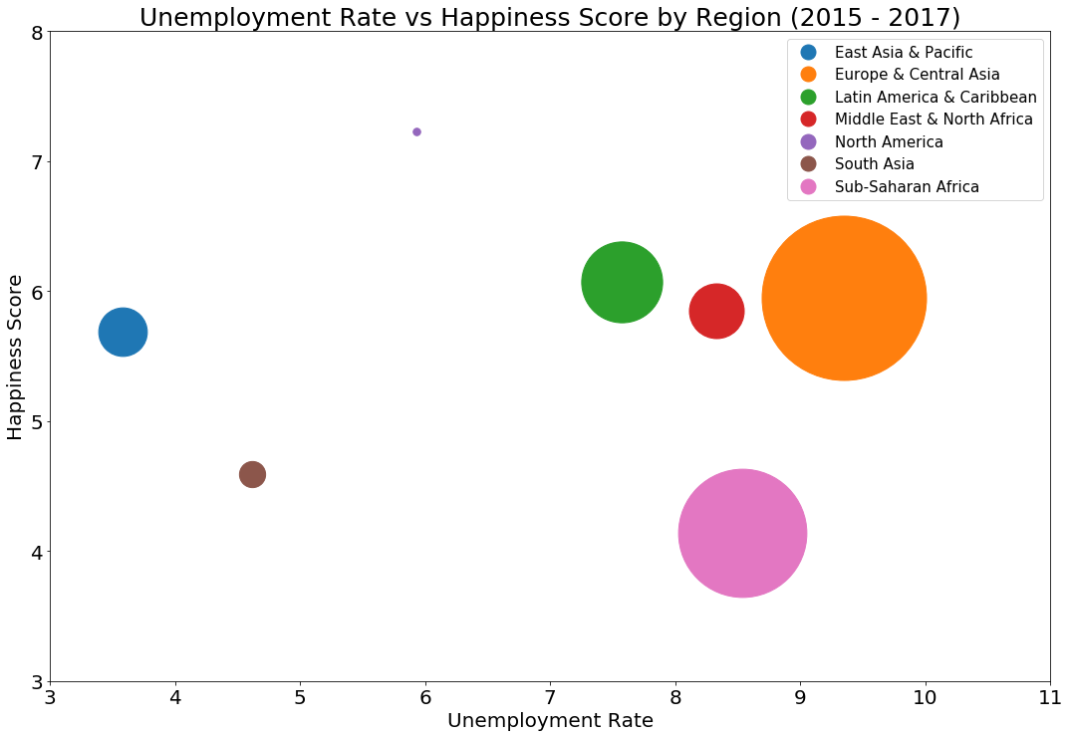
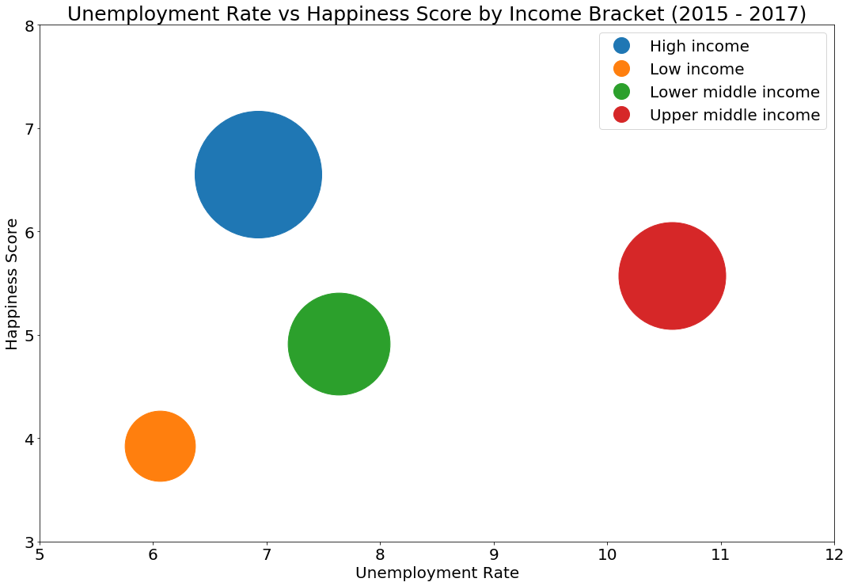
Analyzing Happiness Score Based on Unemployment Rate (2015 - 2017)
Happiness score is inversely proportional to unemployment rate.
North American countries have highest happeniness score with considerably lower unemployment rate.
East Asia & Pacific have better happiness score and lowest unemployment rate.
Sub-Saharan African is the least happy region and unemployment rate is comparatively high.
Countries in high income bracket have highest happiness scores.
Low income countries have lower happiness score regardless of low unemployment rate

Slide 34
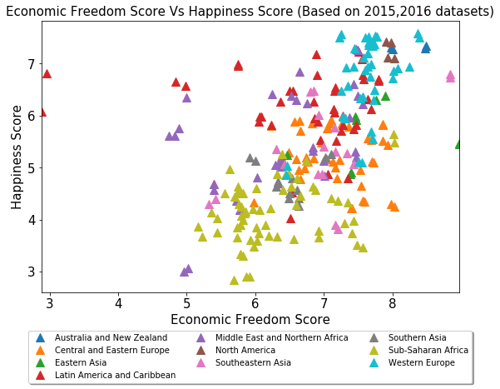
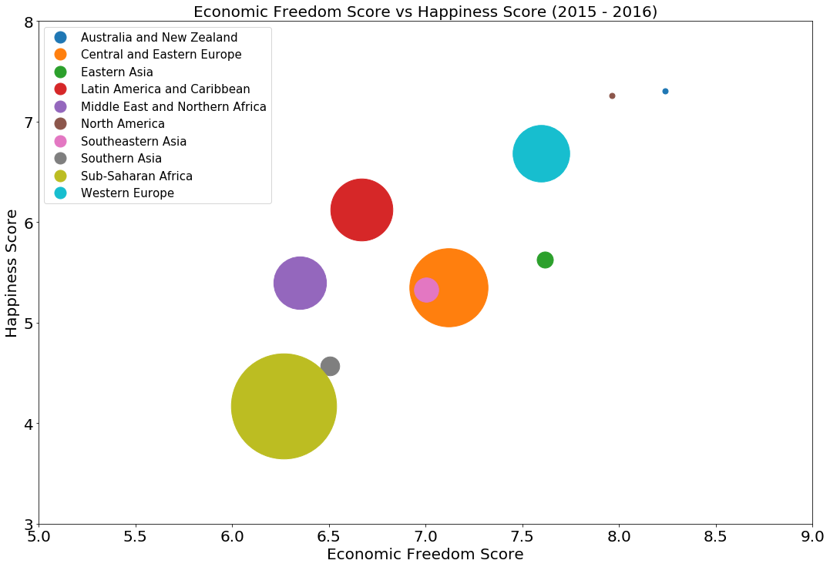
Analyzing Happiness Score Based on Economic Freedom (2015 -2016)
The economic freedom is an important factor contributing to the happiness score of a country.
North America, Australia and New Zealand are happiest regions with best economic freedom.
Western European region have highest happiness score and have comparatively good economic freedom.
Sub-Saharan Africa is the least happiest region with lowest economic freedom.

Slide 35
CONCLUSION
Family, Economic GDP per Capita, Health Life Expectancy, Social Freedom, Economic Freedom, Generosity, Corruption are some of the major factors influencing the world happiness score.
Countries which have lower unemployment rate and high income have higher happiness score.
Economic Freedom increases the world happiness rate.
Happiest countries are in the Western Europe.
Australia and New Zealand, North America and Western Europe are the happiest regions.
Sub-Saharan Africa and Southern Asia are the least happy regions.
As per the latest report Finland is the happiest country in the world.
Considering last 4 years happiness report, top five countries are always from Western Europe

Slide 36
WHAT ELSE IS AN UNDERLYING CAUSE OF HAPPINESS?
DOES HOW PEOPLE “GET” TO SPEND THEIR TIME CONTRIBUTE TO HIGHER SCORES, ESPECIALLY LEISURE TIME?

Slide 37
OECD Data – WHY WE TOOK A LOOK At THIS
17 of the top 20 happiest countries (based on the World Happiness Report 2019) ranked in the top 20 for the World Happiness Report for past 5 years.
Finland has ranked in the top 6 over the past 5 years.
The United States has dropped from 15th to 19th over the past 5 years. What’s up with that?
Interestingly, several of the happiest countries are OECD members.
We reviewed OECD data to see what insights we could uncover on Leisure Time, Volunteer Time , and Personal Time in relation to Happiness.
In particular, we took a look at Finland compared US.
Rank (World Happiness Report 2019) | Country | OECD Country | I# of times in the top 20 Happiness Index past 5 years
1 | Finland | Yes | 5
2 | Denmark | Yes | 5
3 | Norway | Yes | 5
4 | Iceland | Yes | 5
5 | Netherlands | Yes | 5
6 | Switzerland | Yes | 5
7 | Sweden | Yes | 5
8 | New Zealand | Yes | 5
9 | Canada | Yes | 5
10 | Austria | Yes | 5
11 | Australia | Yes | 5
12 | Costa Rica | No | 5
13 | Israel | Yes | 5
14 | Luxemburg | Yes | 5
15 | United Kingdom | Yes | 3
16 | Ireland | Yes | 5
17 | Germany | Yes | 4
18 | Belgium | Yes | 5
19 | United States | Yes | 5
20 | Czech Republic | Yes | 1
https://stats.oecd.org/Index.aspx?DataSetCode=TIME_USE

Slide 38
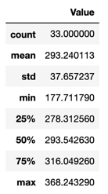
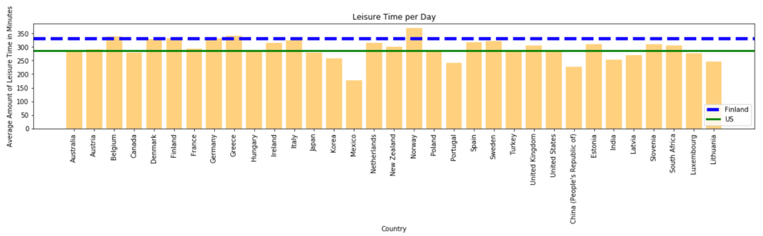
Leisure Time
Rankings in the Upper Quartile
#1: Norway is the highest ranked at ~368 mins
#2: Greece ~341 and #3 Germany ~331
#4: Finland ~330 and #5 Denmark ~328
US in the Lower Quartile at ~ 286 min
OECD Definition: Leisure Time spent socializing; attending cultural, entertainment and sports events; in hobbies, games and other pastime activities; participating in sports and outdoor activities; using mass media; performing other leisure activities.
(Note: Data spans different years for different countries).
Source: OECD Database

Slide 39
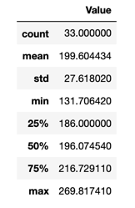
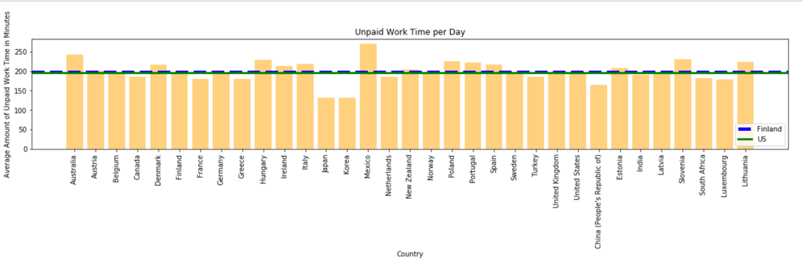
Volunteering (used Unpaid Work Time)
Insights
OECD Definitions includes much more than volunteering in “Unpaid Work Time”
Finland and US are close at ~196
Mexico highest at ~269
Korea lowest at ~131
OECD Definition: Time spent in unpaid work includes: routine housework; shopping; care for household members; child care; adult care; care for non-household members; volunteering; travel related to household activities; other unpaid activities. (Note: Data spans different years for different countries).

Slide 40
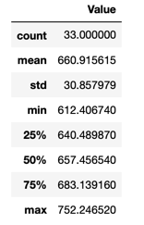
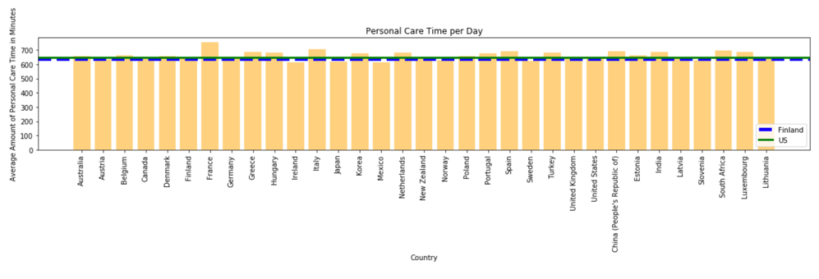
Personal Care Time
Insights
Interestingly, there is less variation in scoring among all participants, making this measure relatively meaningless in comparing happiness.
Finland ~ 640 min and US ~648 min
OECD Data Definition: Time spent in personal care includes: activities required by the individual in relation to biological needs (sleeping, eating, resting etc.); performing own personal or household health-care and maintenance or receiving this type of care; travel for personal care activities in relation to spiritual care; doing nothing, resting, relaxing, meditating, thinking, & planning. (Note: Data spans different years for different countries).

Slide 41
OECD Data-SEt Conclusions
More Leisure Time appears to correlate with increased level of Happiness
Scandinavian countries have consistenly high scores in leisure time & happiness
Need More Research
Volunteering - Need more specific data to determine there is an actual correlation
Personal Care – This appears to be about inline with all OECD countries but not a correlation.

Slide 42
OVERALL
Developed Infrastructure: Urban Population, Internet Usage and Improved Drinking water facilitates higher scores of happiness.
Family, Economic GDP per Capita, Health Life Expectancy, Social Freedom, Economic Freedom, Generosity, Corruption influence the world happiness score.
Countries which have lower unemployment rate and high income have higher happiness score.
Economic Freedom increases the world happiness rate.
Happiest countries are in the Western Europe.
Australia and New Zealand, North America and Western Europe are the happiest regions
More Leisure time plays in role in happiness.
Strangely, suicide rates are not correlated with Happiness.
A lack of Michelin restaurants may be a factor in countries where happiness is super low.

